Slide 2
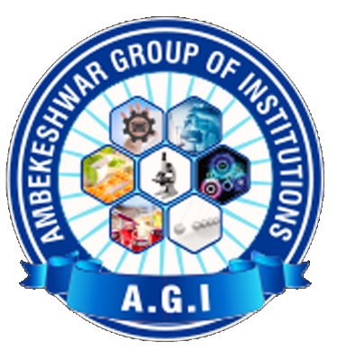
Ambekeshwar Group Of Institution, Lucknow
PRESENTATION
ON
SUMMER TRAINING FROM UPPCL
33/11 KV SUB-STATION, SHOHRATGARH
SIDDHARTH-NAGAR (U.P.)
PRESENTED BY:- SUBMITTED TO:-
Sahyog Rauniyar Mr. Brijesh Kumar Dhore
Branch:- EE 2nd Year (HOD EE Dept.)

Slide 3
CONTENTS
SUBSTATION
SINGLE LINE DIAGRAM
CONCEPT OF BUS
EQUIPMENTS AT BUS STATION
WHAT IS TRANSFORMER
PARTS OF TRANSFORMER
TESTING IN TRANSFORMER
CIRCUIT BREAKER
ISOLATOR
RELAY
INSULATOR
LIGHTNING ARRESTOR
CURRENT TRANSFORMER AND POTENTIAL TRNSFORMER
REFERENCES

Slide 4
WHAT IS A SUBSTATION
A substation is a part of an electrical generation, transmission, and distribution system. Substations transform voltage from high to low, or the reverse, or perform any of several other important functions. Electric power may flow through several substations between generating plant and consumer, and its voltage may change in several steps.

Slide 5
SINGLE LINE DIAGRAM
Single line diagram do not show the exact electrical connection of the circuit. As the name suggests, SLDs use a single line to represent all three phases. They show the relative electrical interconnections of generators, transformers, transmission and distribution lines, loads, circuit breakers, etc., used in assembling the power system. The amount of information included in an SLD depends on the purpose for which the diagram is used.

Slide 6
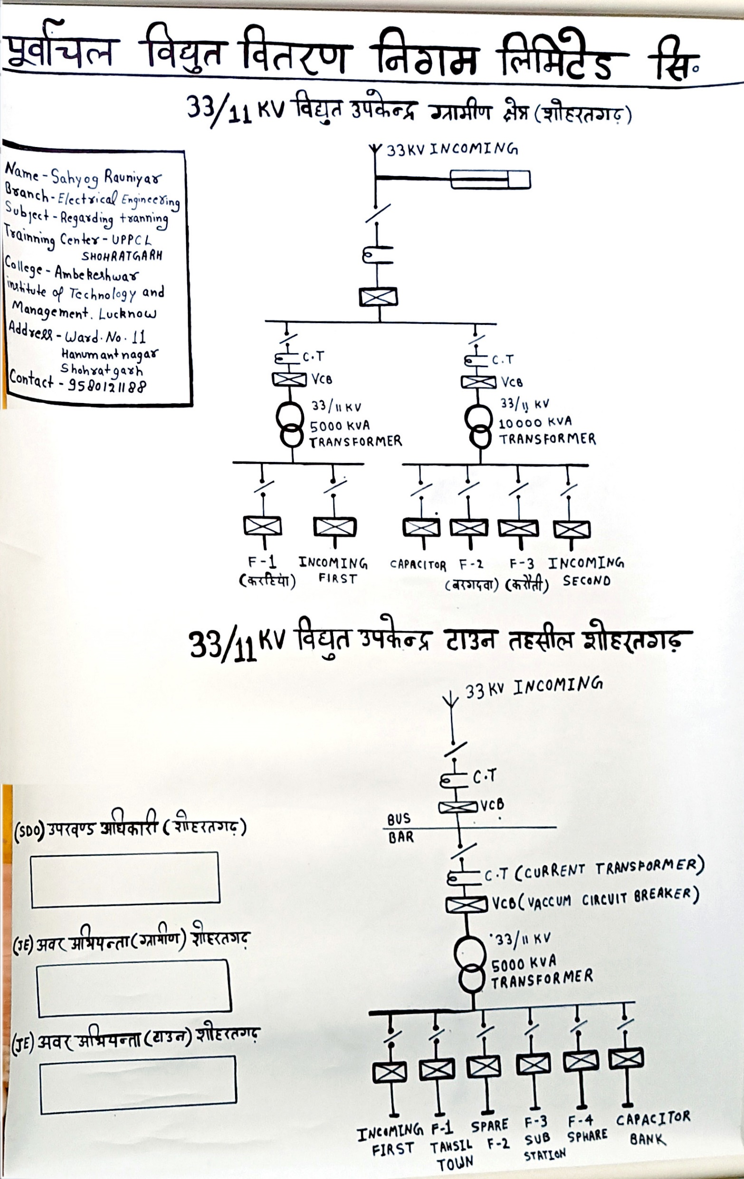

Slide 7
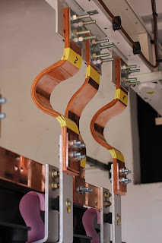
CONCEPT OF BUS
The concept of bus is Same as the concept of a node in an electrical circuit.
There is one bus for each phase.
Shown in SLDs as lines connecting equipment to the buses.
Mad of aluminum or copper bars or pipes and can be several meters long.
The impedance of buses is very low, practically zero, so electrically the whole bus is at the same potential.

Slide 8
EQUIPMENTS AT THE SUBSTATION
MAJOR EQUIPMENT:
POWER TRANSFORMERS
MEASURING INSTRUMENTS:
CURRENT TRANSFORMER
POTENTIAL TRANSFORMER
PROTECTING DEVICES:
ISOLATOR
CIRCUIT BREAKER
RELAY
LIGHTNING ARRESTOR

Slide 9
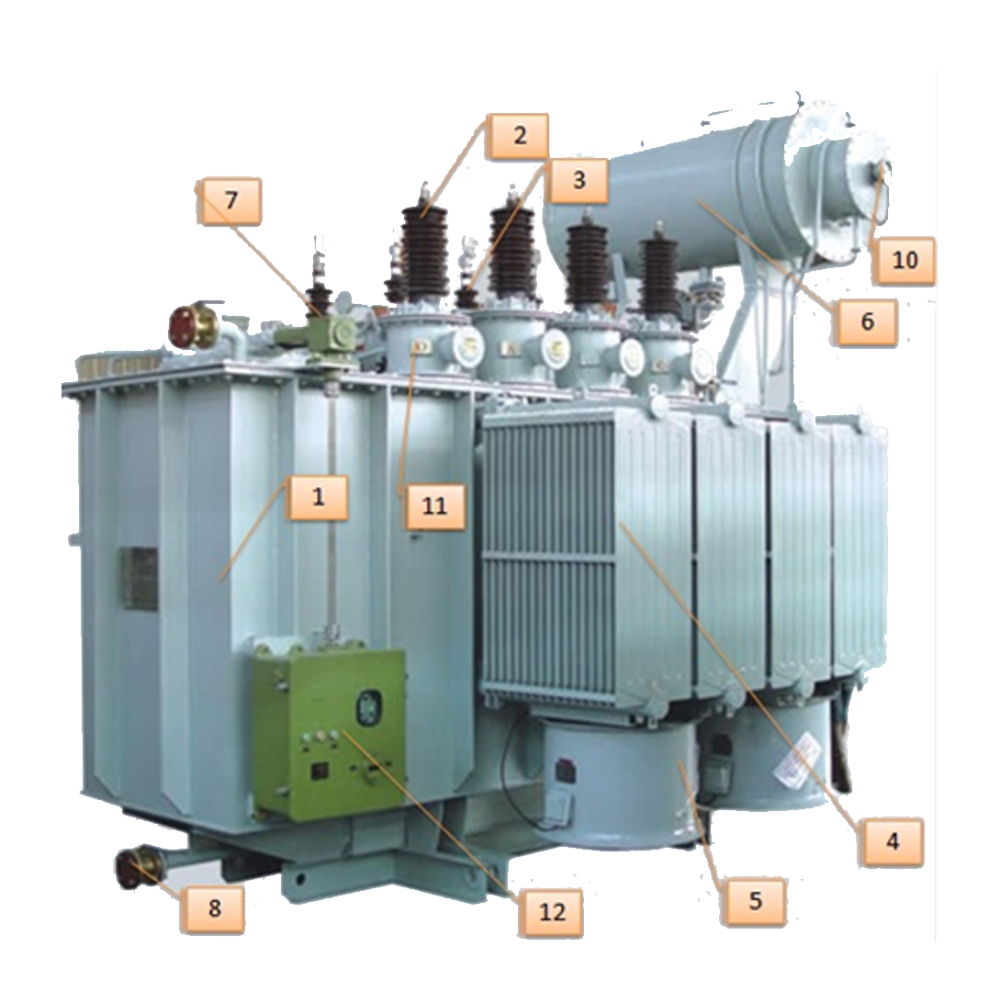
WHAT IS TRANSFORMER
A transformer is an electrical apparatus designed to convert alternating current from one voltage to another. It can be designed to "step up" or "step down" voltages and works on the magnetic induction principle.

Slide 10
PARTS OF THE TRANSFORMER
Transformer Tank
High Voltage Bushing
Low Voltage Bushing
Cooling Fins/Radiator
Cooling Fans
Conservator Tank
System Ground Terminal
Drain Valve
Dehydrating breather
Oil
Temperature/Pressure gauges
Bushing Current Transformers
Control Panel
Surge Arresters

Slide 11
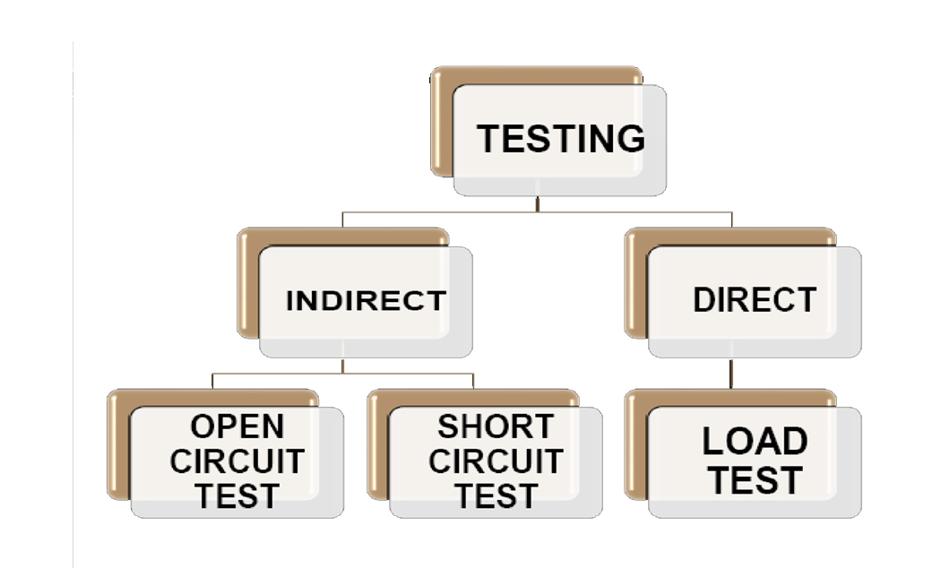
TESTING OF TRANSFORMER

Slide 12
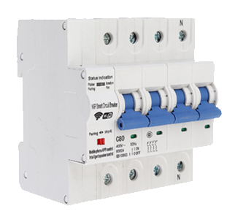
CIRCUIT BREAKER
The basic functions of circuit breaker is protection, which is interruption of short-circuit and overload fault currents.
High-voltage breakers are nearly always solenoid-operated, with current sensing protective relays operated through current transformers.
High-voltage breakers are broadly classified by the medium used extinguish the arc.
Bulk oil
Minimum oil
Air blast
Vacuum
SF₆

Slide 13
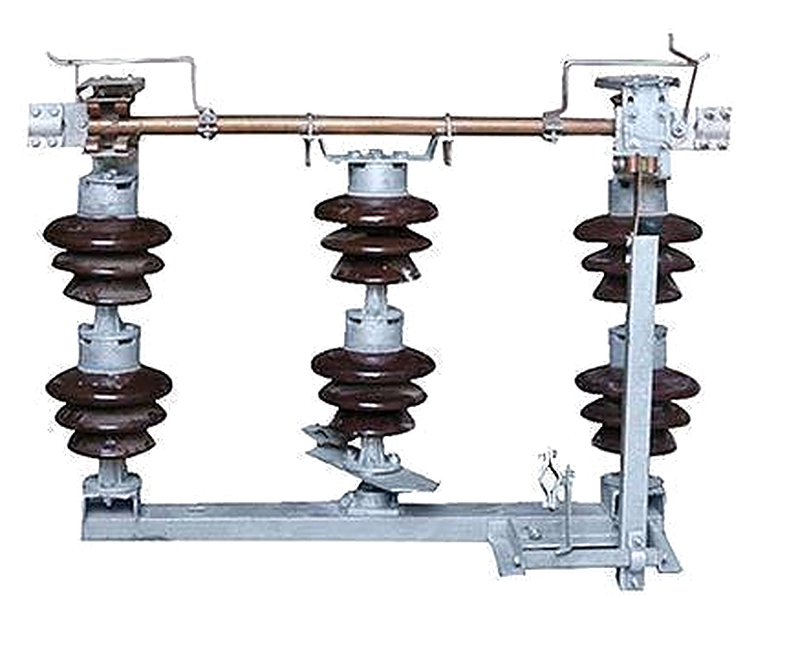
ISOLAOTRS
It is just like a switch is used to make sure that an electrical circuit can be completely de- energized for service or maintenance.
Difference b/w Isolator and circuit Breaker
An isolator r is an off load device, whereas Circuit Breaker is an On load device.
Isolators are operated manually. Circuit Breakers are operated automatically.
Isolators have the low withstand capacity as compared to that of Circuit Breaker.

Slide 14
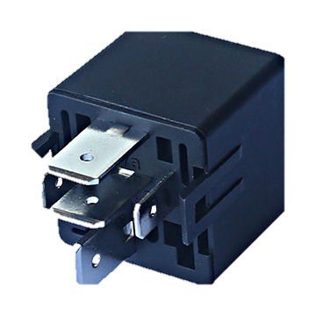
RELAY
A protective relay is an electromechanical apparatus, often with more than one coil, designed to calculate operating conditions on an electrical circuit and trip circuit breakers when a fault is detected.

Slide 15
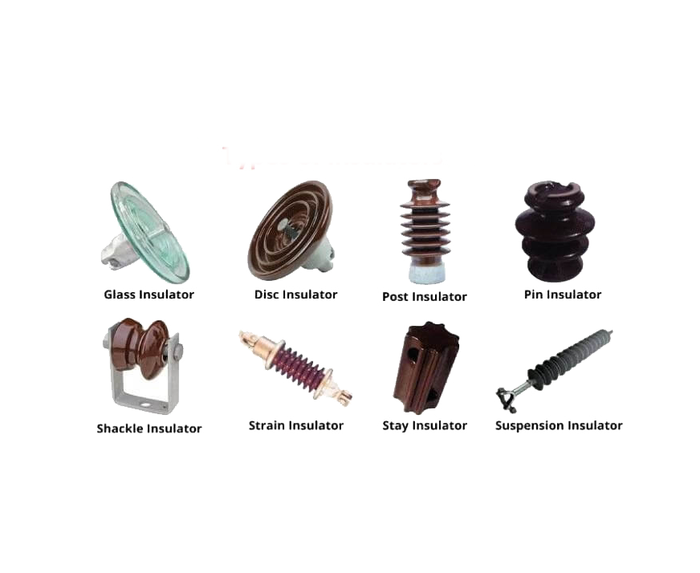
INSULATOR
An electrical insulator is a material in which the electron does not flow freely or the atom of the insulator have tightly bound electrons whose internal electric charges do not flow freely; very little electric current will flow through it under the influence of an electric field.

Slide 16
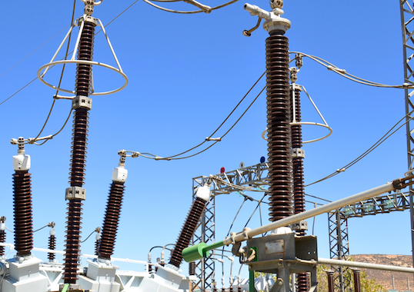
LIGHTNING ARRESTOR
A lightning arrester is a device used on electrical power systems to protect the insulation and conductors of the system from the damaging effects of lightning.
When a lightning surge travels along the power line to the arrester, the current from the surge is diverted through the arrestor, in most cases to earth.

Slide 17
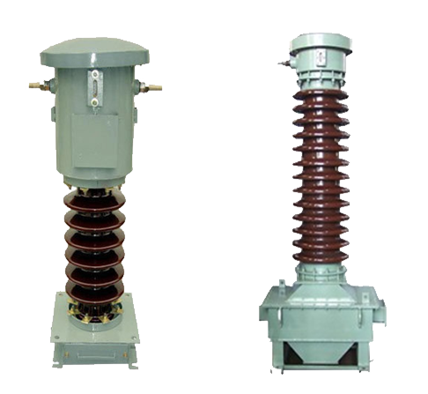
CURRENT TRANSFORMER AND POTENTIAL TRANSFORMER
Current transformers (CT), together with Potential transformers (PT) are known as instrument transformers.
A current transformer is a type of transformer that is used to reduce or multiply an alternating current. It produces a current in its secondary which is proportional to the current in its primary.
The potential transformer may be defined as an instrument transformer used for the transformation of voltage from a higher value to the lower value.
CT
PT

Slide 18
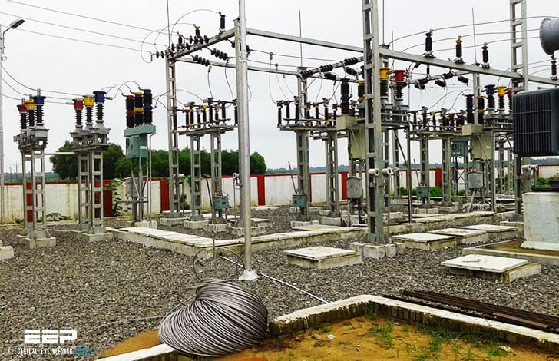
33/11 KV Substation Yard

Slide 19
CONCLUSION
The main function of the substation is to collect the energy transmitted at high voltage from the generating station and then reduce the voltage to an appropriate value for local distribution and gives facilities for switching.
33/11 kv Substation is used to step down voltage from 33 kv to 11kv and the output is connected to feeder for local utility.
substation of rating 33/11kV means, the substation has been designed to receive 5 MVA of power at 33 kV and it will distribute the same on 11 kV.

Slide 20


